Slide 1


Slide 2
Plentiful Job Opportunities
Career Advancement
banking
Challenging Work
Leadership
Community Service

Slide 3


Slide 4
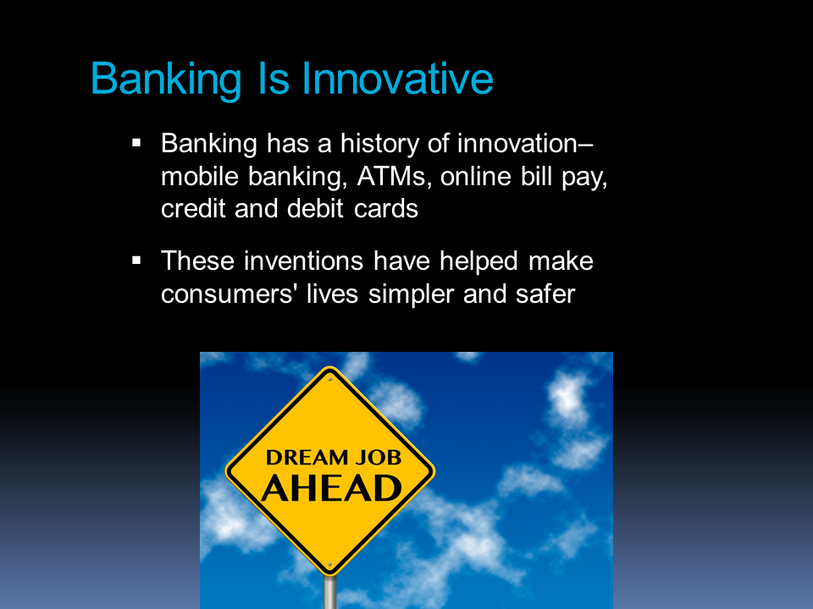

Slide 5
Banks Employ 2 Million People
25%
Tellers
41%
Administrative and
Branch Operations
34%
Corporate and Management
Source: Bureau of Labor Statistics, 2013

Slide 6












Diverse Job Opportunities
customer sales representative
computer network technician
electronic banking officer
economist
human
resources manager
attorney
agricultural lender
accountant
marketing manager
teller
Commercial loan officer
Compliance officer

Slide 7
So What Does it Take to Become a Banker?
Desire to work with people
Good communication skills
Desire to learn and grow
Good credit history
College degree for a bank officer’s position or a specialized function

Slide 8
The Outlook:
We’re Hiring
According to the Bureau of Labor Statistics, bank employment is projected to grow through the remainder of this decade.
One major growth area:
Compliance

Slide 9


Slide 10


Slide 11


Slide 12



Best Perk of Being a Banker: Giving Back to Your Community

Slide 13
Explore the Opportunities
Careers banking
in

