Slide 1

OCTOBER 16-20, 2017
Notes:
Hello and welcome to the 2017 Wisconsin Get Into Energy, Careers in Energy presentation. In just a few minutes, you will learn about career opportunities in a sector that is exploding with possibility. The only question is, are you ready to get in on the action? Click the screen or use the right arrow key to advance to the next slide

Slide 2



Energy is all around us, but have you ever considered an energy career?
Notes:
When you think of energy, what do you think of? A light bulb? An outlet? A nuclear power plant? Maybe you should see energy as something more: as a career. Just like you rely on your cellphone, TV, lights, computer and other technology, so too does this technology rely on people who devote themselves to bringing energy into Wisconsin homes and businesses. Advance to the next slide to learn more about how energy reaches to every corner of our daily lives.

Slide 3

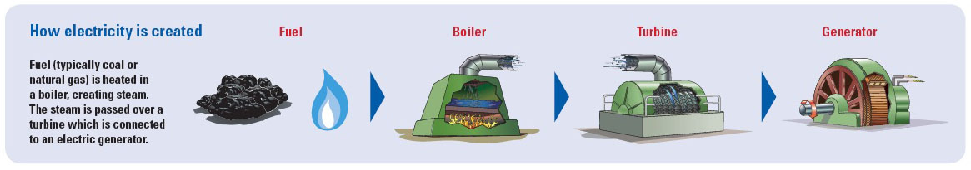
How electricity is provided
Video: Meet the grid

Slide 4

If you are interested in:
  A good salary and job benefits
  Opportunities for advancement
  Job growth and stability
  Service to your community
  Training and apprenticeships
…then a career in energy
may be for you!
Notes:
What sorts of things would you like to see in your future career? A good paycheck? Fulfilling daily work? Stability? These things and more are available to you through a career in energy.

Slide 5
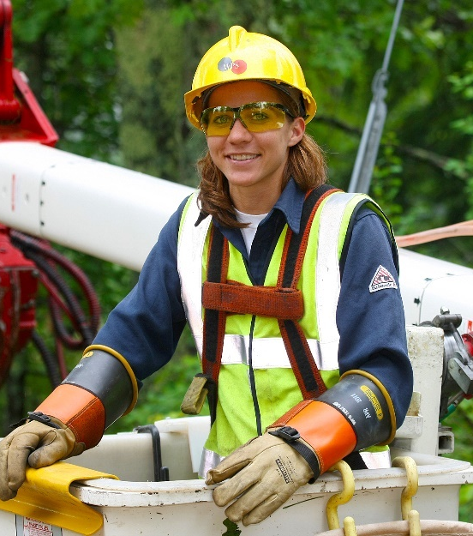

Key career areas:
  Line technician
  Gas utility technician
  Plant operator
  Engineer
Other areas include designer, vegetation management, mechanical maintenance
and more.
Notes:
Here are a couple of career opportunities available in the diverse field of energy.

Slide 6

Line technician
Duties | Install and repair cables, wires and other transmission equipment
Work examples | Inspect and test power lines Lay underground cable Identify defective switches and wires
Education and requirements | Technical college diploma in electrical power distribution (9 months) Commercial Driver’s License
Experience | Electrical, construction or maintenance
Skills | Cooperative attitude Good listening skills Ability to be on your feet for long periods of time Comfortable with heights and working outdoors
Starting pay | $29 to $39 per hour / $60,000 to $80,000 per year
Notes:
First, let’s look at a career that many people first think of when they think of energy. Line technicians are responsible for installing and maintaining electrical poles and transmission towers. Those interested in math and engineering would love working as line technicians. Duties of a line technician include calculating electric loads and doing hands-on maintenance of electrical poles. Besides receiving a technical diploma in electrical power distribution, line technicians must also have a clean driving record in order to receive a commercial driver’s license, or CDL. Line technicians, like other in-the-field energy careers, start out as apprentices making an average base pay, and after four years experience, become journeymen who make more money annually.

Slide 7
More than just a job
Video: More than just a job

Slide 8

Gas utility technician
Duties | Install, maintain and operate natural and propane gas distribution systems
Work Examples | Lay out pipe routes Install pipes for steam and/or gas mains Find and repair or replace pipes
Education and requirements | Technical college diploma in gas utility construction and service (9 months) Commercial Driver’s License
Experience | Mechanic, excavation or construction
Skills | Work well on your own Patience Ability to stick it out when things go wrong
Starting pay | $31 to $41 per hour / $64,000 to $85,000 per year
Notes:
Next, another in-the-field career opportunity is becoming a gas utility worker. Women and men working as gas utility workers install and maintain natural and propane gas distribution systems. Like line technicians, gas utility workers must obtain a technical college diploma before becoming an apprentice in their field. Also, those working to become gas utility workers must maintain a clean driving record so that they may receive a CDL. If you’re interested in engineering, becoming a gas utility worker may be the right career option for you. You’d be working with large equipment that connect customers to the energy they need everyday.

Slide 9
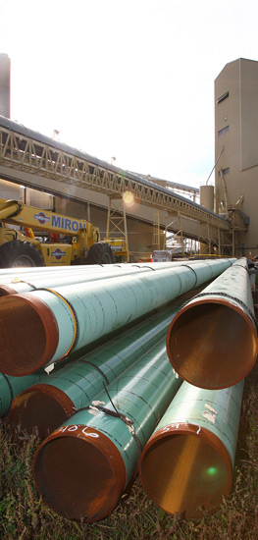
Power plant maintenance mechanic
Duties | Analyze, install, maintain and repair equipment that generates power
Work Examples | Operate various equipment such as cranes and heavy equipment
Education and Requirements | Technical college industrial maintenance diploma (2 years)
Experience | Three years of plant experience
Skills | Problem solver Concentrate and be on your feet for long periods of time
Starting Pay | $31 per hour / $64,000 per year
Notes:
Instead of working out in the field, you could also work inside large power plants as a maintenance mechanic. After receiving a technical college mechanical diploma, you’d work with large equipment used to make mechanical repairs in facilities that are the source of the energy we use in our daily lives. While three years experience is sometimes required, other times this experience is not required, and experience is instead gained through on the job training. If becoming a maintenance mechanic isn’t for you, other job opportunities at a power plant may include: power plant assistants, system control operators, and instrument and control technicians.

Slide 10
Power plant careers
Video: Power
plant careers
Notes:
Click on the link in the center of your screen to watch a video on power plant careers.

Slide 11

Who plays a role in installing wind turbines?
Utility engineers
Geophysical engineers
Concrete and structural engineers
Turbine engineers
Site and civil engineers
Microelectronic and computer programmers
Business and financial professionals
Legal professionals
Meteorologists
Notes:
One of the most talked about and exciting fields within the broad sector of energy is wind energy. If renewable energy excites you, consider the career opportunities below.

Slide 12
Green jobs: Wind energy
Video: Wind energy

Slide 13


Other energy career opportunities
  Accountant
  Programmer analyst
  Designer
  Engineer
Notes:
Maybe you’d rather work in an office that in a power plant or out in the field. If so, one of the following careers may be perfect for you.

Slide 14

Accountant
Duties | Prepare and maintain financial documents, apply accounting policies and investigate issues found
Work examples | Document financial transactions Prepare balance sheets and other reports Maintain accounting controls and recommend action
Education | Bachelor’s degree in accounting (4 years)
Experience | 1+ year in basic accounting 1+ year computer systems and applications
Starting pay | $37,000 to $58,000 per year (associate) $80,000 to $100,000 per year (CPA)
Notes:
Let’s look at accounting. If numbers and math are your thing, you’d love becoming an accountant for an energy company. You’d use analytical and math skills every day to ensure that company finances are in order. To become an accountant, you need a bachelor’s degree in accounting, as well as some experience using accounting skills and working with computers. With every year you put into an accounting career, the more likely you are to increase your annual income.

Slide 15

Programmer analyst
Duties | Analyze problems and create solutions for other areas of the company
Work examples | Code and test applications Install software Provide technical support
Education | Associate or bachelor’s degree in computer science, management information systems or computer engineering (2 to 4 years)
Experience | 1+ years in computer application development
Starting pay | $20 to $32 per hour / $42,000 to $66,000 per year
Notes:
Consider yourself to be an analytical person who loves working with technology? Well, becoming a programmer analyst could be the perfect way to express your passions. After receiving a bachelor’s degree in a computers related field, you could become a programmer analyst where you would code and test applications for an energy company. You would work with computers to find software problems and come up with creative solutions to these problems. Computer efficianatos? This career is for you.

Slide 16

Designer or engineer
Duties | Provide technical support for field personnel by overseeing construction, maintenance and operations
Education | Designer: Degree in drafting/design (2 years) Engineer: Bachelor’s degree in engineering (4 years)
Experience | Internship/co-op experience, process management experience, ability to use computers
Starting pay | Designer: $22 to $40 per hour / $45,000 to $83,000 per year Engineer: $25 to $50 per hour / $52,000 to $105,000 per year
Notes:
If you like art and design and value creativity, you should consider a career in either design or engineering. In both of these jobs, you would use computers and creative thought while working on construction and maintenance projects. Designers require a technical college degree in drafting or design, while engineers require a bachelor’s degree in engineering.

Slide 17

More energy career opportunities
  Agri-business/science
  Business administration
  Chemical engineering
  Computer science
  Construction management
  Communications
  Electrical engineering
  Facilities management
  Finance
  Graphic design
  Geographical Information Systems
  Human resources
  Industrial engineering
  Information technology
  Management information systems
  Marketing
  Mechanical engineering
  Production and operations management
  Public and government relations
  Risk management
  Safety management
Notes:
Obviously, we don’t have the time to describe all of the career options available to you within the energy sector. But, if you want to learn about even more career opportunities in energy, take time to read the following job titles or even print off this slide to do some research on your own.

Slide 18

Preparing for an energy career
In high school:
Get good grades
Keep a clean driving record
Take courses related to your field of interest
Take core courses in:
      Science
      Technology
      Engineering
      Mathematics
Notes:
So, what can you do in high school to prepare for a career in energy? Obviously, you must get good grades so that you can go on to college for further education. Also, keep a clean driving record so that you are eligible for obtaining a CDL. Finally, take some courses in science, technology, engineering and math so that you can explore what peaks your curiosity.

Slide 19
Preparing for an energy career
In college:
Join student organizations in your field
Gain leadership experience:
      Be elected to a club/organization leadership position
      Become a student teacher or teacher assistant (TA)
      Attend leadership seminars
      Improve public speaking skills
Sign up for internship or job co-op
Volunteer within your community
Notes:
In college, you must continue to get good grades to prepare for a career in energy. But, there’s more to do. Get involved in some student organizations, become a student teacher or teaching assistant, work an internship, and do some volunteer work within your local community. These things can help you stand out on job applications and propel you towards a dream career in energy.

Slide 20


Get Into Energy
Begin your journey to an exciting, rewarding career in energy.
Visit getintoenergy.com to find career profiles, watch videos, take skills tests and learn more about careers in energy.
Notes:
Click on the link below to utilize valuable resources such as skills tests and videos to expand your knowledge of careers in energy. But, there’s one thing you need to ask yourself right now: are you ready to begin your journey into a rewarding career in energy?

Slide 21


Wisconsin technical programs for utility careers
Notes:
Here are some Wisconsin technical schools with programs in utility careers. Click the pictures to learn more about each school.

Slide 22


Additional resources
Classroom activity: Careers in energy – research, interviews and job shadowing
www.uwsp.edu/cnr-ap/KEEP/Documents/Activities/CareersinEnergy.pdf
Energy education field trips and guest speaker listing
www.uwsp.edu/cnr-ap/KEEP/Pages/Resources/Field-Trips-and-Speakers/Field-Trips-and-Speakers-Home.aspx
Notes:
For more interactive and educational resources on energy careers, click on the links and pictures below.

Slide 23


















Thank you to these Wisconsin sponsors for supporting Careers in Energy Week.
Notes:
Finally, if you want to learn about some great energy companies that could become your future employers, click the logos below. Some even have internship and job shadowing opportunities!

Slide 24
For more information on careers in energy, visit:
consortia.getintoenergy.com/wisconsin/
Notes:
Thank you for viewing this PowerPoint presentation focused on careers in the energy industry. We hope you found the information relevant and beneficial. Please take a couple minutes to answer four questions that will help us improve energy-related career information and services we provide. For more information on Careers in Energy, visit the Get into Energy Wisconsin website at http://consortia.getintoenergy.com/wisconsin/.

